Slide 1

Litecast
Flexible, Scalable and Uniform Local Data-Sharing in Real-Time
Thesis Part-2
Mid-Term Project Evaluation
Presentation by:
oliver kandir (25cs06006)

Slide 2
Work Done So Far
Developed a simulation to study, verify, and improve the working of LiteCast.
Identified problems in the current implementation of LiteCast.
Proposed solutions to address the identified problems.

Slide 3
Simulation
Implemented in C++ based on the details provided in the original paper.
Simulation code and results are publicly available on GitHub.
The obtained results resemble the results reported in the paper.
Repository Link: OliverKandir/LiteCast-Simulations-Cpp: C++ simulation implementations developed as part of my M.Tech thesis, based on the published LiteCast research.

Slide 4
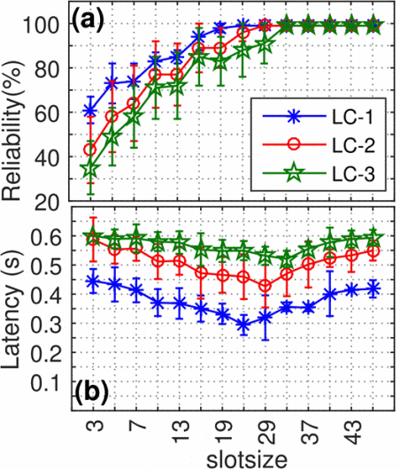
RESULTS FROM THE PAPER

Slide 5
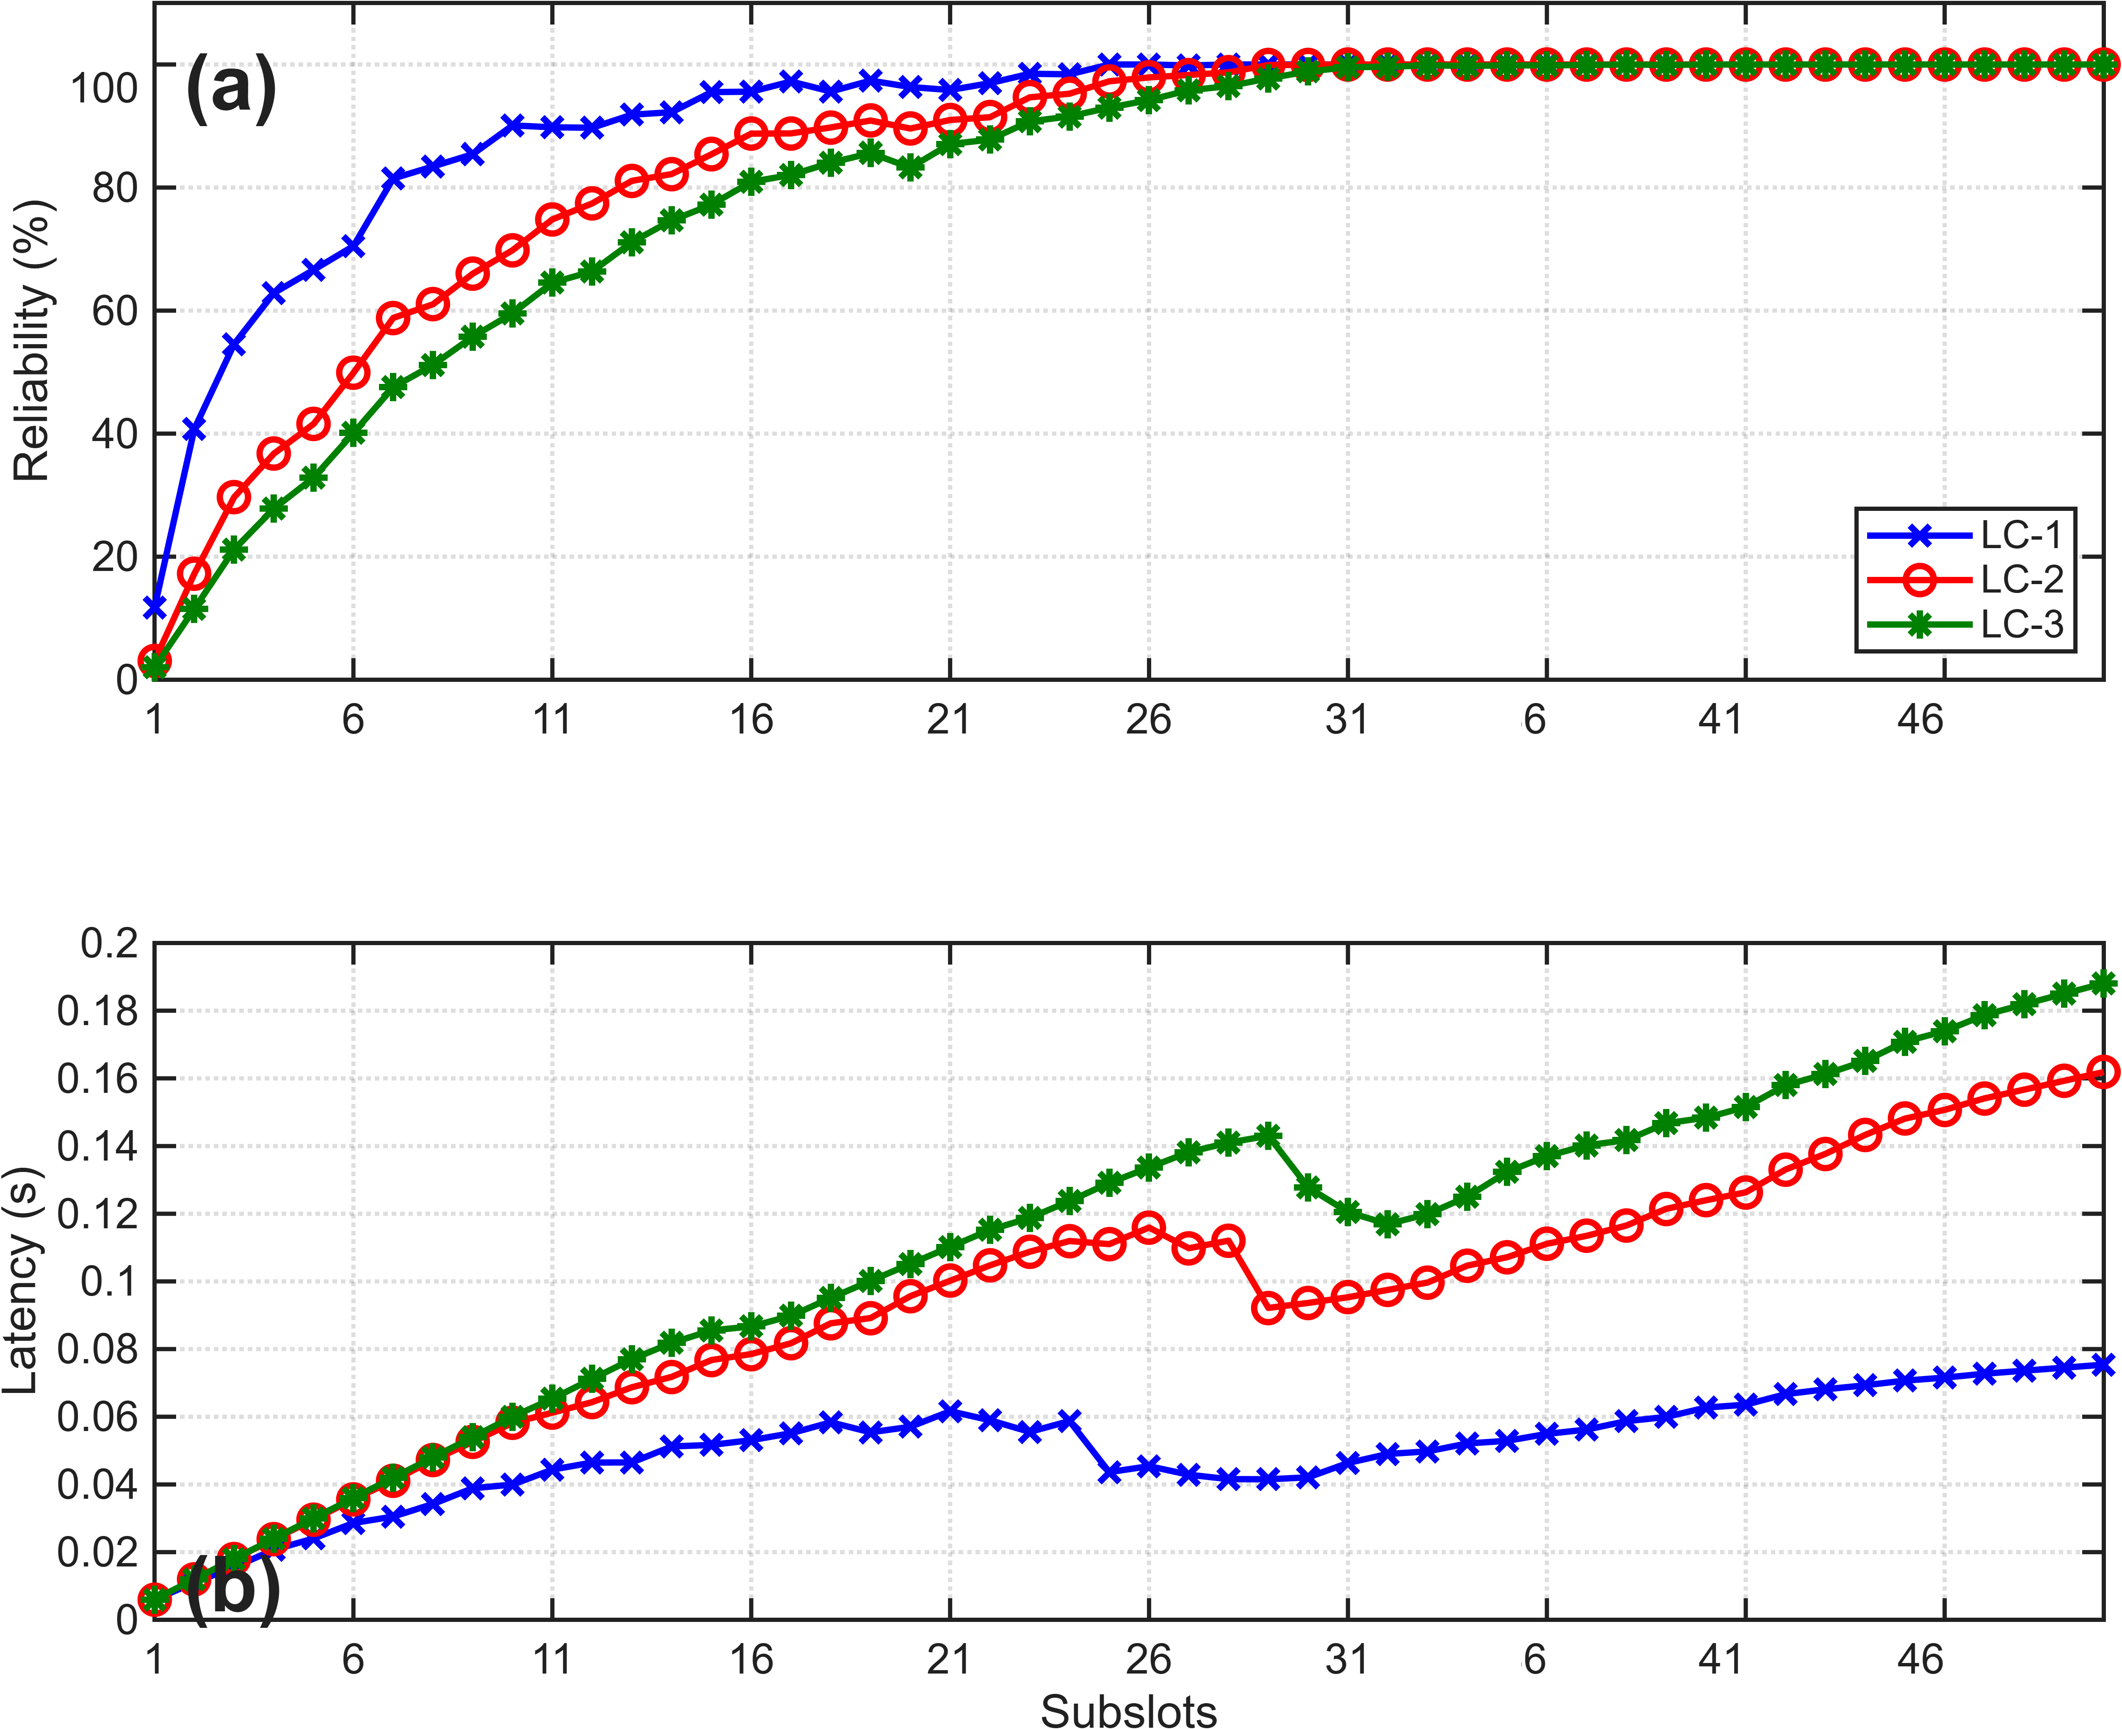
RESULTS FROM THE SIMULATION
The simulation reproduces the general reliability and latency trends reported in the LiteCast paper.

Slide 6
SIDE-BY-SIDE RESULTS
Simulation Results Paper Results

Slide 7
GOAL
The major goal of LiteCast is to achieve Local Coverage (many to many dissemination) in the minimum amount of time. LiteCast achieves this by operating with the minimum Slotsize that is collision free.
For example, if a locality contains only 5 nodes and these nodes are perfectly mapped to 5 subslots, the locality can achieve LC-1, LC-2, and LC-3 in the minimum amount of time, even if the overall network contains hundreds or thousands of nodes.

Slide 8
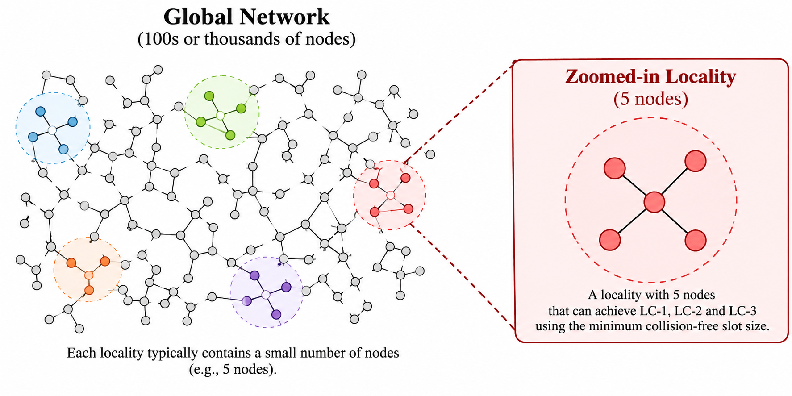
Example

Slide 9
BASELINE
When the number of subslots equals the number of nodes and each node is mapped to a unique subslot, all nodes have collision-free reservations.
This configuration can support any Local Coverage level without subslot collisions.

Slide 10
Problems Identified
The initiator does not provide the node IDs to the nodes. Therefore, the hash function uses preconfigured IDs or MAC addresses for subslot assignment.
Collision is possible: For example, consider a 5-node network using a modulo-5 hash function. If the node IDs are 5, 25, 35, 105, and 55, then all five nodes are assigned to the same subslot (0) and transmit in the same subslot.

Slide 11
Problems Identified
Suppose we ensure that Node IDs range from 1 to the number of nodes in the network and set the slotsize equal to the maximum degree of the network, where:
  Maximum Degree < Number of Nodes
Collision is possible: Proof:- by the Pigeonhole Principle, if the number of subslots is less than the number of nodes, at least one subslot must contain more than one node. Therefore, a collision is unavoidable, regardless of the hash function used.

Slide 12
Effects of Collision
Collision always occur at the receiver side. This can result in the following cases:
Head to head collision: Two nodes transmit in the same subslot due to this receiver is not able to decode any of their data results in.
Data loss goes undetected: When a node transmits then it might collide at one receiver but other receives and acknowledges it, hense data loss at one receiver goes undetected.

Slide 13
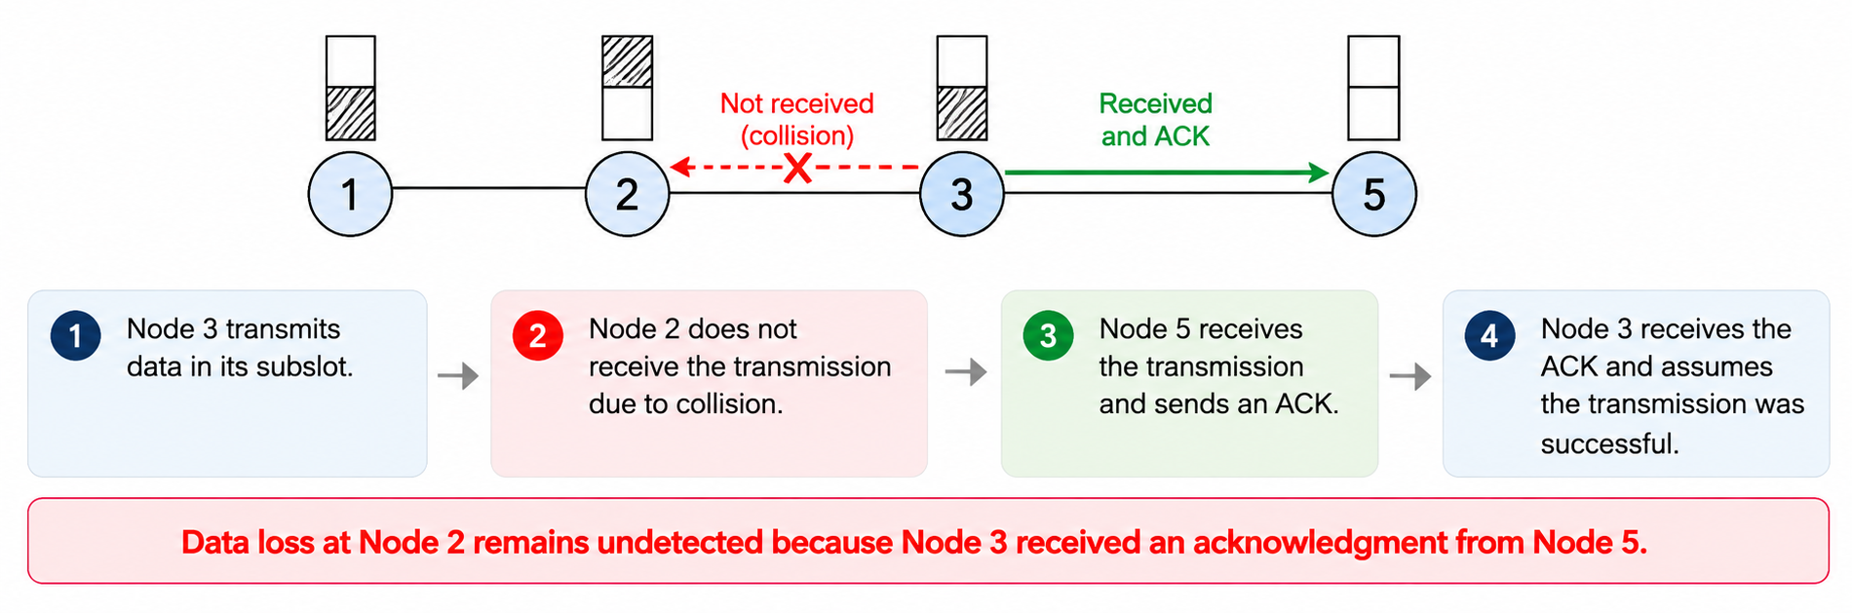
Effects of Collision
Data loss goes undetected:

Slide 14
Solutions
A node that does not receive an acknowledgment waits for a random amount of time before retransmitting, using a mechanism similar to exponential backoff.
Fixes: Data loss due to head-to-head collisions.

Slide 15
Solutions
If a node knows its K-hop neighbors, where K is an integer, it can explicitly request data sequentially from nodes whose data was not received during the normal LiteCast operation.
Sequential requests ensure that nodes transmit one at a time, avoiding additional collisions during data recovery.
Fixes: Loss due to head-to-head collisions and undetected data loss at individual receivers.

Slide 16

Explored Improvement Possibilities
Original LiteCast: Uses Originator Hop Count (OHC) to determine whether received data belongs to the intended locality:
If the condition is satisfied, the data is obtained and forwarded; otherwise, it is discarded.
Problem observed: During simulation, nodes were receiving LC data beyond the intended locality.
Attempted solution: Introduced TTL to ensure that nodes receive only LC-specific data.
New problem: The same data packet with different TTL values could compete within the same subslot, resulting in collisions that would otherwise be mitigated by Constructive Interference (CI).

Slide 17
OHC vs. TTL: Key Findings
Constructive Interference (CI): For CI to work properly, the transmitted packets must have identical headers and data payloads.
Observed in simulation: OHC-based filtering performed better in reliability than TTL-based filtering. However, TTL-based filtering ensured that LC-2 data did not compete with LC-3.
Under complete reservation: OHC-based filtering achieved 100% reliability, whereas TTL-based filtering did not even under complete reservation.
Overall finding: In our simulations, the OHC-based implementation provided higher reliability than the TTL-based implementation.

Slide 18
Challenges and Conclusion
Neighbor discovery: Determining how a dynamically joining node obtains the list of its neighbors remains a challenge..
Multi-hop neighbor discovery: Some standards provide beaconing mechanisms for identifying one-hop neighbors, but extending this mechanism to discover two-hop or three-hop neighbors remains an open challenge.
Dynamic network participation: Although LiteCast is described as dynamic, the initiator-assigned parity remains fixed. A newly joining node must therefore synchronize with the existing network before it can receive data.
Conclusion: The simulations reproduced the key behavior of LiteCast and helped identify limitations related to subslot collisions, undetected data loss, and data filtering.

Slide 19
Thank you

